Slide 1

Prioritizing Primary Prevention - Innovative Financing Mechanisms and Successful Community Partnerships
September 3, 2014
1:00-2:30pm EDT
Thank you for joining us. The webinar will begin shortly.
Join us in Atlanta for our
Annual Conference
Sept 10-12, 2014.
Register today at
mentalhealthamerica.net/AnnualConference

Slide 2
Prioritizing Primary Prevention - Innovative Financing Mechanisms and Successful Community Partnerships
September 3, 2014

Slide 3
Financing and Implementation of Primary Prevention: An Overview
Sarah M. Steverman, Ph.D., M.S.W
&
David L. Shern, Ph.D.

Slide 4
Presentation Overview
Challenges and opportunities
Federal financing
ACA related prevention financing
Insurance financing for prevention
Private financing of prevention
Implementation strategies
Example – 5 Town CTC
Example – MHA of OK

Slide 5
Challenges
U.S. trails other developed nations on many indicators of health and wellbeing
Highest rates of mental illness in the world
Lowest performing health care system of 16 comparable nations
Highest rates of incarceration in the world
Lagging academic achievement
These are significant threats to our competitiveness/quality of life

Slide 6
Opportunities
Behavioral health is a key factor for addressing these challenges
We have well studied interventions that can impact most of these areas
Financing for these interventions is spread across
Levels of government
Sectors of interest
Private, public and philanthropic sources
Notes:
First bullet – emphasize BH is integral to general health and social indicators – educational attainment, JJ/CJ, poverty, etc.

Slide 7
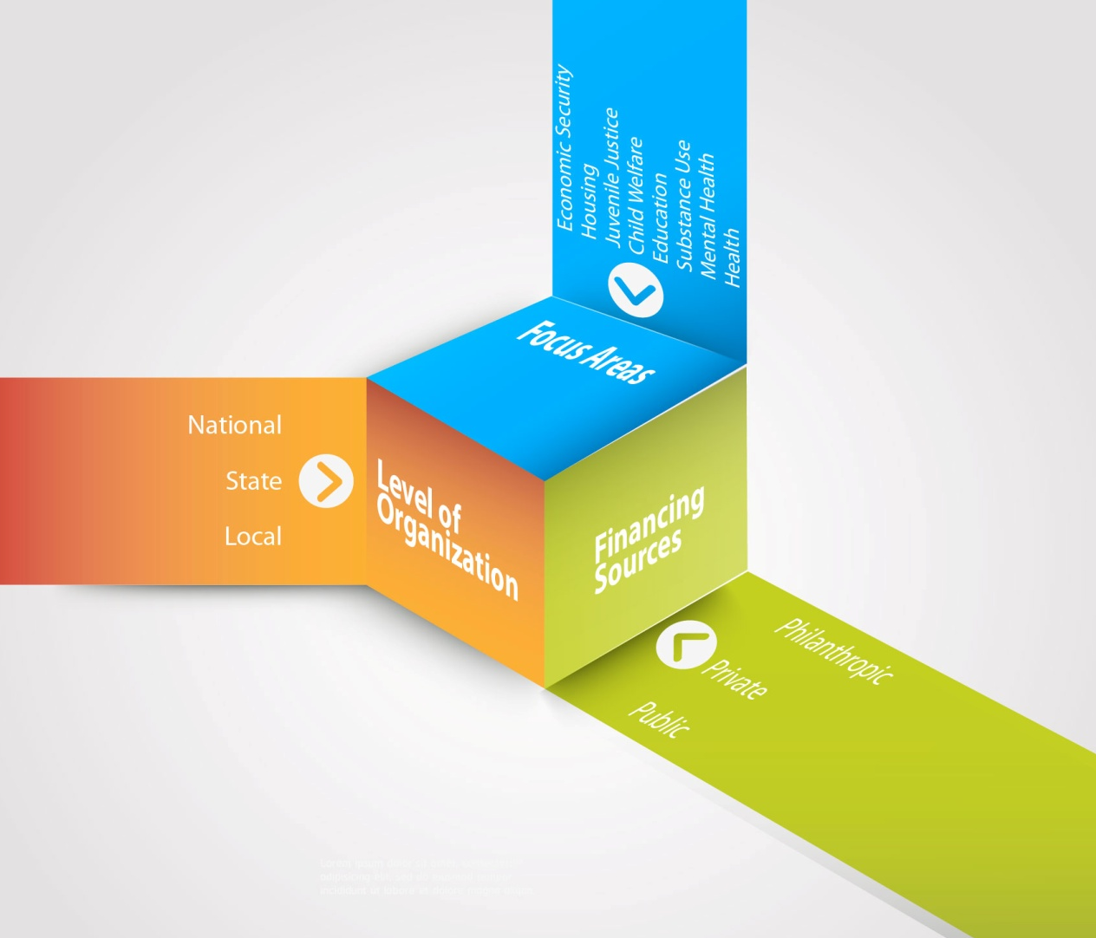
Schematic Representation of Prevention Financing

Slide 8
Challenge for Stakeholders
How best to understand and coordinate these diverse sources of funding
Develop funding in areas that are not well supported
Understand the overall yield of our investment
Ensure sustainability of prevention funding
Community based organizations can be the drivers of these activities
Notes:
Sarah begins

Slide 9
Opportunities
General health and behavioral health can be promoted, and health and social problems can be prevented.
General health, behavioral health, and social outcomes share a common set of predictors that are of concern to many different human service sectors
Sectors have shared overall goals of healthy development, but different financing, interventions, and indicators
Federal, state, and local stakeholders are invested in individual, family, and community wellbeing
Notes:
Compared with other countries, declining health and social outcomes – BH, general health (obesity, diabetes, infant mortality, etc.), educational outcomes, violence, poverty, etc.
Broadly conceived prevention – from bio/genetics, programs/services for individuals to community development, state and federal laws, etc.

Slide 10
Opportunities
A substantial science base exists that demonstrates the value of primary prevention interventions on
Pro-social behaviors
Reduction of risk factors
Educational and occupational achievement
Psychosocial and interpersonal functioning
Prevention of mental health and substance abuse conditions
Over the lifetime
Notes:
This is from our presentation last year – this could be deleted

Slide 11
Opportunities
This value is reflected in improved human capital with savings in both direct and indirect public expenditures in
Education
Health
Criminal Justice
Child Welfare
Social Welfare Programs
As well as improved human capital contributing to increased productivity and broadly distributed societal good.
Business and employer benefits
Increased community and civic engagement
Improved family and individual health and well-being
Notes:
Define human capital
This is from our presentation last year – this could be deleted

Slide 12
Intervention Costs and Benefits
Intervention | Total Benefit | Taxpayer Benefit | Cost | Net Value | Benefit to Cost Ratio
Seattle Social Development | $15,238 | $4,591 | $3,081 | $12,157 | $4.94
Good Behavior Game | $8,890 | $2,655 | $158 | $8,732 | $56.34
Strengthening Families (10-14) | $4,259 | $1,061 | $1,098 | $3,160 | $3.89
Communities that Care | $2,079 | $626 | $574 | $1,505 | $3.70

Slide 13
Overarching Goals
Every individual should have the opportunity to live, learn, work and play in safe, nurturing and caring environments that support healthy development.
Every individual should have access to evidence-based primary prevention and promotion programs, just as they have access to preventive vaccinations and other public health goods and services.
Notes:
Goals of human service sectors, not just BH
Note: Environmental strategies and programmatic strategies
This is adapted from last year’s webinar – but it might be good to point out at the beginning that we’re talking about both environmental strategies and prevention programs

Slide 14
Opportunities for Prevention
Building evidence of the effectiveness of prevention
Increasing recognition of the need to get ahead of problems and the interconnectedness of health and social problems
ACA presents new opportunities and incentives for prevention
New interest by business in prevention
Recognition of shared interest by sectors
Success of coalitions and community partnerships

Slide 15
Constraints on Prevention Financing and Implementation
Miniscule proportion of health care expenditures related to prevention (3%)
Medical care system focused on treatment rather than prevention of problems
Medical necessity criteria
Fee for service incentivizes treatment
Mobility of beneficiaries between insurers
Individual beneficiary v. family or population health

Slide 16
Federal Financing
SAMHSA
Substance Abuse Prevention and Treatment Block Grant
SAMHSA Discretionary Programs
Federal Block Grants
HRSA ▪ ACF
CDC ▪ AoA
ED ▪ OJJDP
HUD
Affordable Care Act/CMS
Notes:
SABG – 20% must go to prevention
Fed Block Grants – many different agencies, across lifespan
Discretionary programs – SPF, Partnerships for Success, Launch, SS/HS

Slide 17
Prevention in the ACA
Explicit Recognition of the Critical Nature of Prevention
Grant funds - Prevention and Public Health Fund
USPSTF requirements – Essential Benefits
Universal coverage
Risk-based financing – Oregon CCO model
Community benefits requirements – nonprofit hospitals
Notes:
PPHF – what many/most think of from the ACA
USPSTF – start, but mostly screening. Mention community preventive services task force here?
Universal coverage – Medicaid expansion, marketplaces – provides incentives to keep the entire population healthy
Risk-based – capitated plans give incentive to keep all benefiaries covered (VT model), ACO models can also be mentioned here

Slide 18
Medicaid Waivers
Provide incentives for prevention in the Medicaid population
Primary prevention in clinical settings - Washington Triple P
New York 1115 Waiver - Delivery System Reform Incentive Payment
Notes:
Both clinical/individual and environmental/population-based

Slide 19
Other Sources
Special taxes/levies
Foundations
Health Conversion Foundations
Wellness Trusts
Reinvestment compacts

Slide 20
Pay for Success Financing in Mental Healthcare
Max Crowley PhD
Duke University

Slide 21
Pay For Success
New financial Instruments allow public sector or nonprofits to leverage private capital
Private investors finance the delivery of a preventive program known to reduce service utilization in the future
If the program achieves the expected reductions in service utilization then the investors receive a return on their investment
But if the program fails to achieve the agreed upon cost aversion, then the investors lose some or all of their investment

Slide 22
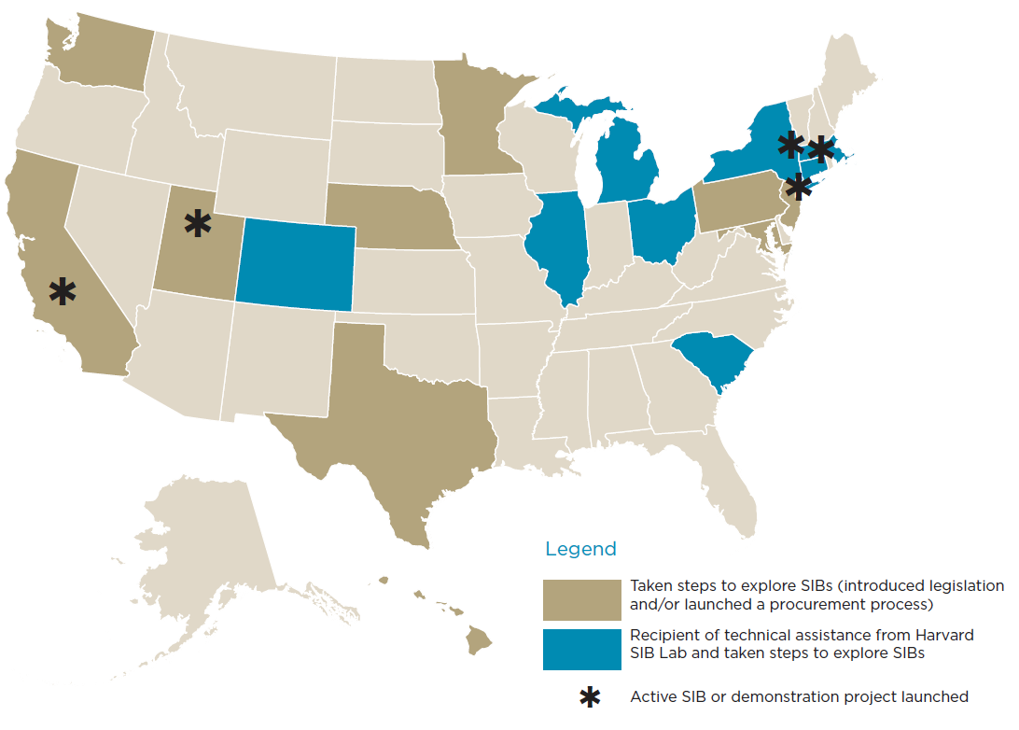
Pay For Success: Activity in the US
Social Finance (2014) State and Local Activity: A Snapshot. http://www.socialfinanceus.org/social-impact-financing/social-impact-bonds/history-sib-market/united-states

Slide 23
Pay for Success: Structure
Government
Intermediary
Investors

Slide 24
Pay for Success: Structure
Government
Intermediary
Investors
City of New York
MDRC
Goldman Sachs

Slide 25
Pay for Success: Structure
Mental Health Program
Cognitive Behavioral Therapy
Service Provider
Osborne Assoc. & Friends of Island Academy
Government
Intermediary
Investors
City of New York
MDRC
Goldman Sachs

Slide 26
Pay for Success: Structure
Mental Health Program
Target Population
Juvenile Offenders
Cognitive Behavioral Therapy
Service Provider
Osborne Assoc. & Friends of Island Academy
Government
Intermediary
Investors
City of New York
MDRC
Goldman Sachs

Slide 27
Pay for Success: Structure
Mental Health Program
Target Population
Juvenile Offenders
Cognitive Behavioral Therapy
Service Provider
Osborne Assoc. & Friends of Island Academy
Government
Intermediary
Investors
City of New York
MDRC
Goldman Sachs
Independent Evaluator
Vera Institute of Justice

Slide 28
Pay for Success: Key Points
Pay For Success Financing is a Rapidly Growing Area
Tremendous Appetite Among Private Investors
Already Bringing Substantial Investments in Mental Health Services
Savings Often Outside of Mental Health
Need to Ensure Programs Have High Quality Evidence of Public Savings

Slide 29
Q & A

Slide 30
Key Elements of Implementation
Emphasis on measurement
Application/use of prevention research
Blending/diversification and sustainability of funding
Promotion of understanding across sectors
Development of social capital – importance of relationships
Implementation infrastructure
Notes:
Implementation and evaluation is such an important part of a successful SIB, therefore we need to get implementation right

Slide 31
Community Coalitions – Increase Coordination and Strategic Direction
Close to the heart of the problems
Key representatives from broad stakeholder groups
Engage community leaders
Member buy-in and commitment
Integration of new members
Notes:
PROSPER/CTC
forming coalitions that include important community leaders and stakeholders,
conducting a systematic needs assessment,
identifying evidence-based interventions that respond to these needs,
implementing targeted interventions that address these needs with fidelity, and
conducting ongoing program evaluation.

Slide 32
Community Coalition Strategies
Strategic Prevention Framework
Needs assessment
Enhance capacity
Plan based on needs and capacity
Implement interventions
Evaluate success
Develop Data
Very structurally similar to Communities that Care and PROSPER models

Slide 33
Gaining Funding and Political Buy-in
Demonstrate observable and measurable “early wins”
Tie intervention success to positive behaviors
Observable changes promote current well-being
First person accounts and testimonials
Demonstrate observable effects on institutional indicators
Promote implementation, sustainability and scaling of intervention using a positive relational frame
Notes:
Purveyors can help with this – marketing strategies to gain funding and get decision makers on board (from Dennis)
Demonstration programs must have easily observable and measurable "early wins," which are identified by participants and stakeholders. For the GBG, this is typically rapid reduction in problem behaviors that are noted by teachers, administrators, students, and parents.
In addition to a reduction in problems, program success is often tied to an increase in positive behaviors, including increased pro-social behaviors, self-regulation, and feelings of hope.
The observable changes affect current well-being (helps kids, teachers, and families feel better) rather than specific reductions (present or future) in diagnosable MEB disorders.
First person accounts or testimonials can be utilized in conjunction with program evaluation data.
After 6-12 months, the program has an observable effect on institutional indicators associated with the cost and burdens related to MEB problems.
Marketing of the program must be done with a positive relational frame, utilizing language that positively demonstrates the program's outcomes (e.g., improved student well-being and school environment), rather than a discussion of problems (e.g., reduction in MEB disorders), which can inadvertently create stigma and introduce negative connotations to the program.

Slide 34
Community Examples
Five Town Communities that Care – prevention coalition
MHA of Oklahoma – school and housing partnerships

Slide 35

Dalene Dutton, MS
Five Town Communities That Care, Maine

Slide 36
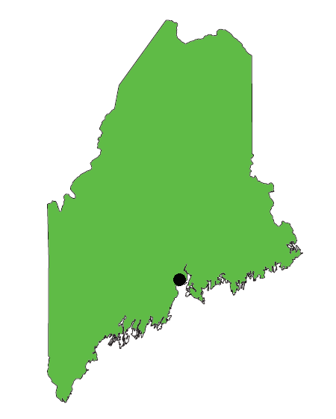
How Five Town CTC got started:
In 2003, our community in midcoast Maine needed help to address youth mental, emotional, and behavioral disorders…and the Social Development Research Group at the University of Washington needed an additional study site to test the CTC system.
Notes:
(Mention suicides)

Slide 37
Original funding:
The five-year research trial provided funds for one staff person and some overhead, and $50,000 of program funding in years 2-5.
Just as importantly, it provided training in CTC, which includes coalition development, prevention science, data analysis, and program evaluation.

Slide 38
Shift in funding:
During the five years of our first grant, we were able to attract some additional funding from corporate foundations (Verizon), local foundations (Maine Community Foundation), and a few local donors.
Having good, LOCAL data that we could clearly tie to desired outcomes—and having established partnerships and desire to form true collaborations—positioned us more favorably in funders’ eyes.

Slide 39
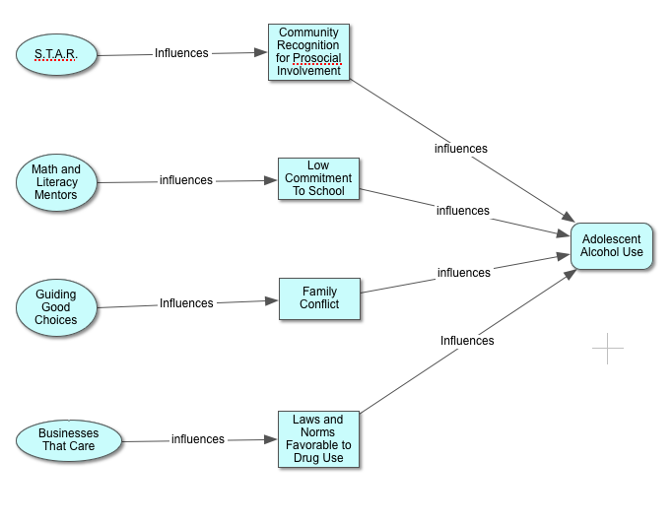
Notes:
We could demonstrate how different programs can contribute to a particular problem behavior, and explain how we were tracking effectiveness at each stage.

Slide 40
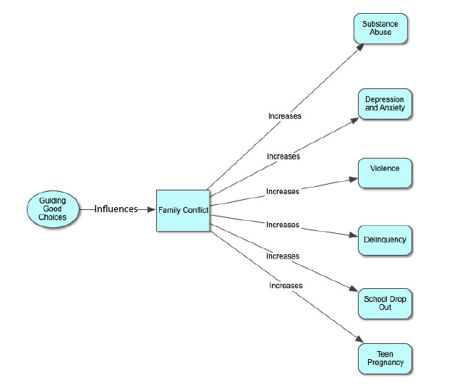
Notes:
Because we focus upstream, we can demonstrate how reduction in one risk factor contributes to a variety of problem behaviors—allowing us to seek funding for a particular program from funders focusing on different outcomes.

Slide 41
Frank, regular discussions that clarify roles and goals of each organization (part of the CTC structure) allow the community to be able to minimize duplication of effort—and for organizations to consider new partnerships.
Partnerships include program delivery, program endorsement, information sharing, loaning one another specialized staff, and fund-raising events.

Slide 42
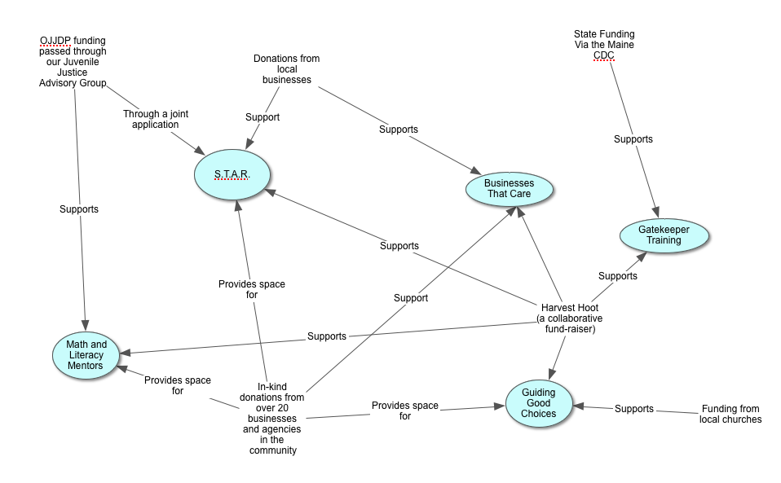
Notes:
Explain some of the details, but this is to give the idea of multiple funding streams. Mention DFC funding via SAMHSA.

Slide 43
Current funding:
We now are able to attract significant support from local donors and fundraising events.
In-kind donations make a real difference in what we are able to do, especially in terms of youth programming.
We have also been successful in our bids for some state funding (delinquency prevention funds).
Local municipalities include us in their budgets.
In addition, we have been able to leverage our expertise to generate a modest income stream from consulting.
Notes:
Share details about partnerships that led to joint fundraising (know we can grow the pie, rather than split it into more pieces)
Don’t fail to consider the value of in-kind donations (space, expertise, audience sharing).
In Maine, no county-level funding for prevention.
Modest amounts, but now have buy-in.
Building expertise and sharing it can be a win-win. (free services in our service area, charge outside)

Slide 44
Points to note:
Use of data
True Collaborations
By working upstream (focus on risk and protective factors) we can effect multiple problem behaviors
Develop your capacity and use it
Put community needs first

Slide 45


Mike Brose, MSW
Executive Director

Slide 46
MHA Oklahoma - Advocacy and Prevention
Redefining prevention in a “downstream” state
Historical use of institutions and high cost uncompensated care
Rejection of Medicaid expansion
Political moment in time
Developing partners and champions
20th Annual Zarrow Symposium - All Things Prevention

Slide 47
Schools and Prevention
Building partners and credibility “one crisis at a time”
Bringing TeenScreen, SafeTeam, and other screening tools into school settings as primary prevention
Flexibility, training, school counselors in Oklahoma
Primary care settings
Funding through private foundations and corporations
Garrett Lee Smith funding

Slide 48
Housing Development As Prevention
“Housing First” Safe, affordable and decent
850 units, 20 apartment buildings, in 16 different neighborhoods
Debt-free ownership
Prevention from becoming homeless and returning to homelessness
Preservation of affordable housing (slowing gentrification)
Partnerships with Housing Authorities and private developers

Slide 49
Development of Funding Streams
Privately funded capital campaigns for bricks and mortar, and services
Housing tax credits
HUD Continuum of Care
HUD HOME Funds and ESG
Rapid Rehousing
SAMHSA funding for services
State contracts
VA contracts
Federal Home Loan Banks

Slide 50
Q & A
Today’s recording, slides, and other resources can be found at http://mentalhealthamerica.net/mha-webinars

